Slide 1

UNLOCKING
Liane Stevenson @webdevelopwolf www.webdevelopwolf.com

Slide 2
INTRODUCTION
Let’s get on the road…

Slide 3

WHAT DID WE DO LAST TIME?
Finding out what Ionic is and does
Starting our first Ionic Mobile App
Looking at how navigation works in Ionic
Creating a skeleton app

Slide 4
WHAT ARE WE DOING TODAY?
Forget what you know about the navigation stack
Types of navigation
What Ionic can do with components

Slide 5
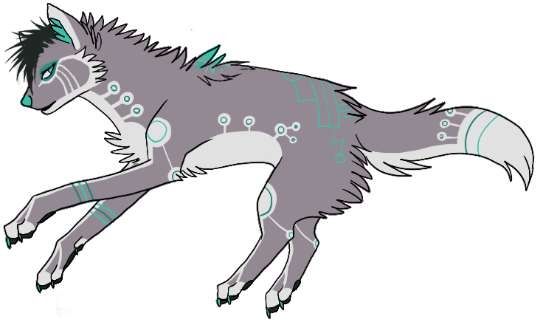
Need Help?
Github:
http://www.github.com/webdevelopwolf/training
Twitter:
http://www.twitter.com/webdevelopwolf
Facebook:
http://www.facebook.com/webdevwolf

Slide 6
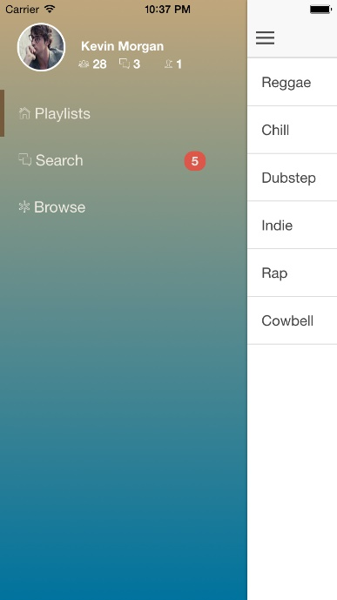
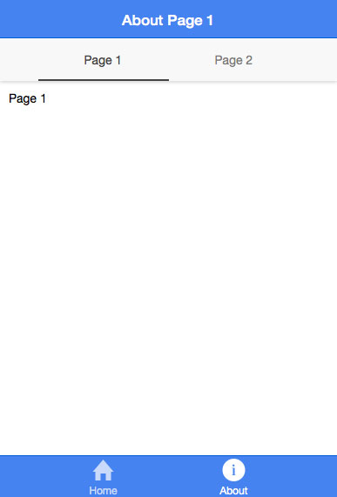
Navigation Types
Two types of navigation in Ionic
Side Menu $ ionic start myApp sidemenu
Tabs $ ionic start myApp tabs
For usability reasons it’s best to choose just one
Which one is right for your app?

Slide 7
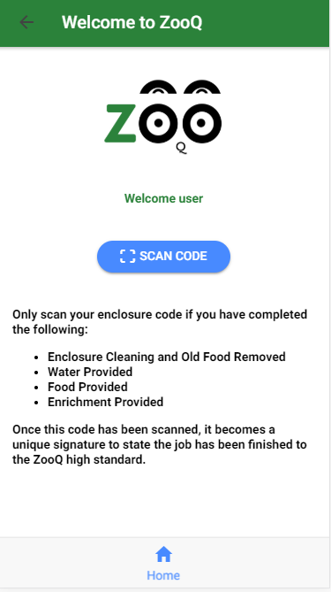
Navigation Types Tabs
Tabs give the user a very familiar user experience first adopted by Apple iPhone
The example to the right simply use’s the device camera to read a code
We want this app to feel like an extension or feature of the device

Slide 8
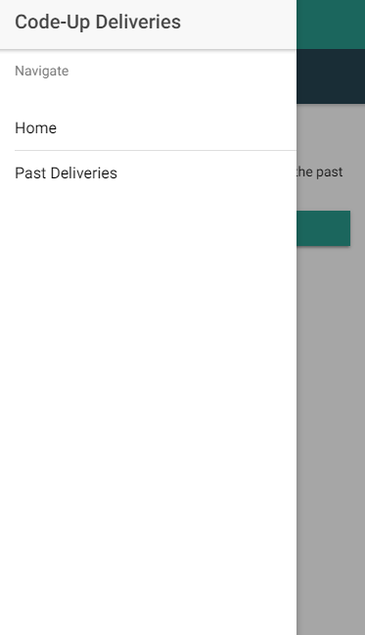
Navigation For Our Delivery App
We have a lot of pages to navigate with our Delivery App, so we put our links in a side menu
We can customise our menu
Let’s take a look at how we’d do this in our app…

Slide 9
UNLOCKING IONIC
A pandora’s box of awesome, powerful components

Slide 10
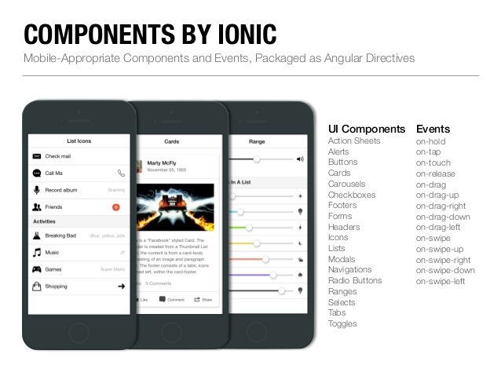
Whoa Li, Slow Down! What’s A Component?
“Ionic apps are made of high-level building blocks called components. Components allow you to quickly construct an interface for your app. Ionic comes with a number of components, including modals, popups, and cards. Check out the examples below to see what each component looks like and to learn how to use each one. ”
From Ionics Online Documentation

Slide 11
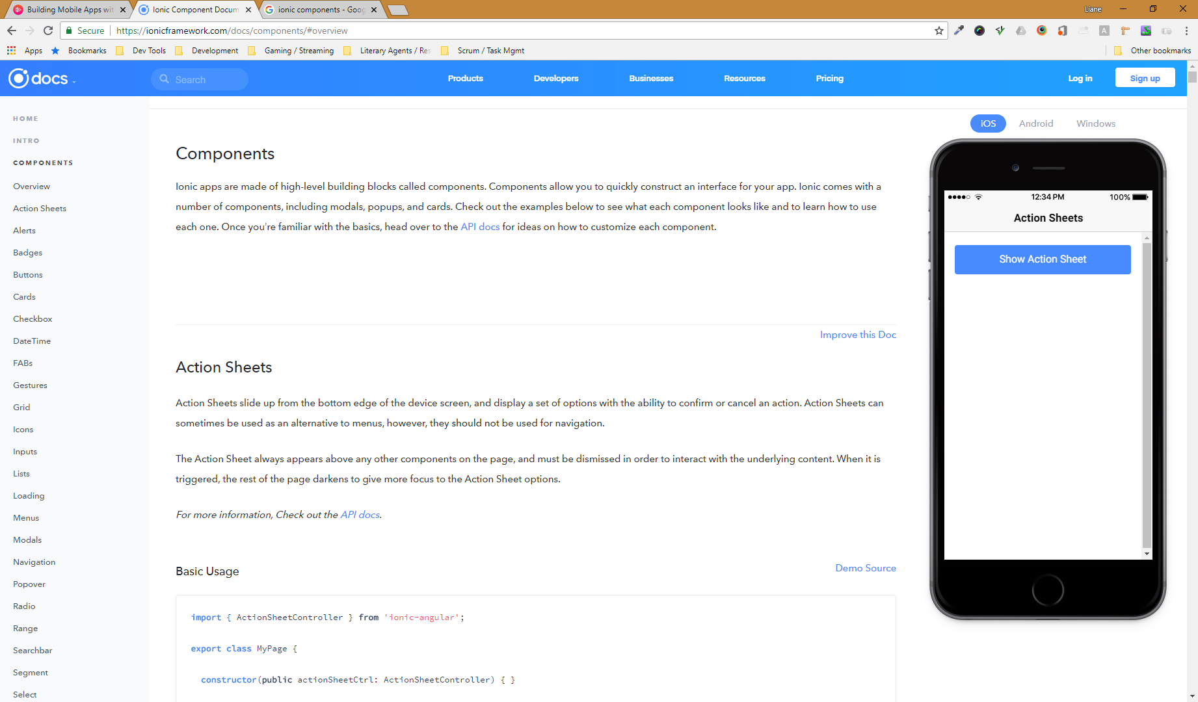
A Small Disclaimer…
There are 20+ components in Ionic
And more can added using plug-ins
We can’t cover them all in depth
We’ll cover as many as possible, but we’ll be covering them in a fly-by fashion
You can learn more about components in the Ionic Documentation
Take a look at the features you find interesting

Slide 12
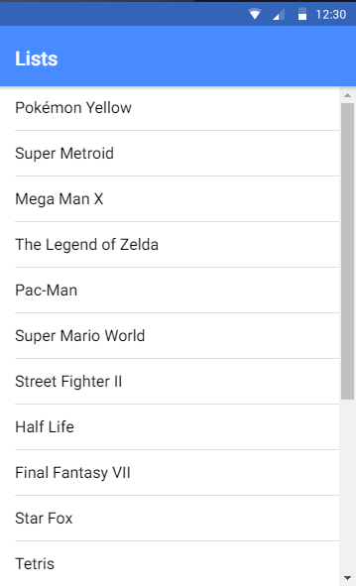
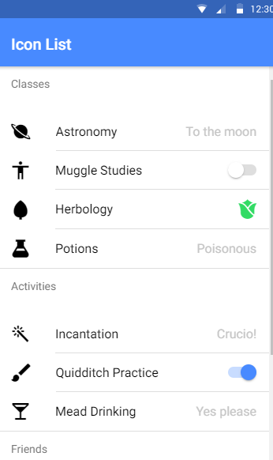
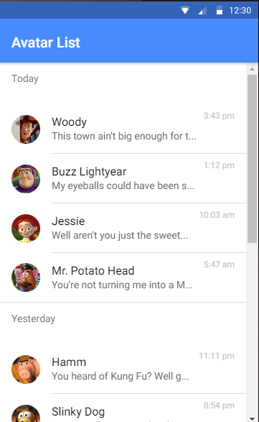
Lovely Lists
Let’s see one of the most commonly used components in Ionic…lists
Used to display rows of information, such as a contact list, playlist, or menu.
Look and feel of these lists is familiar to most smart phone users
There are many types of lists
Let’s add these to our app to display our past deliveries…

Slide 13
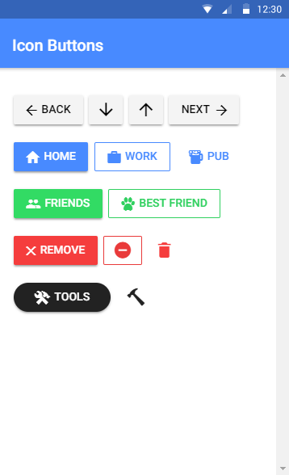
Brilliant Buttons
If lists are the most popular component in Ionic, then buttons are a very close second
Buttons are an essential way to interact with and navigate through an app
Buttons can be whatever you need them to be. We can have unique looks and styles or stick with a very familiar format, but their main function is to push and pop pages on and off our navigation stack
Here’s some of the cool things we can do with buttons
Let’s add a button to our app that tells the user that they are being directed to the Past Deliveries screen…

Slide 14
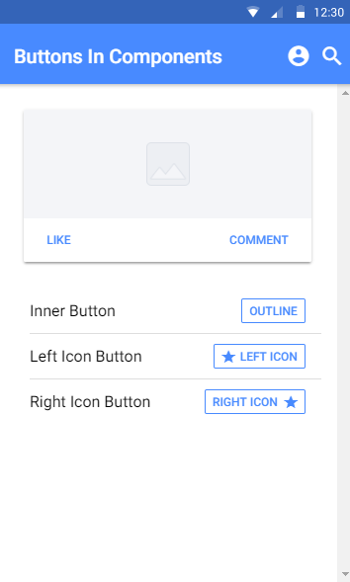
Combo-breaker Components
Why settle for one component when you can have more?
We can create our own super-components that work twice as hard
Not all components can be combined. “I could do this, but should I?” Let’s take a look at a quick example…

Slide 15
WHAT DID WE LEARN THIS TIME?
Forgot what you know about the navigation stack (told you to trust me)
Types of navigation
What Ionic can really do with some cool components

Slide 16
THIS TIME’S CHALLENGE!
Pick a component that we haven’t added yet and add it to your app using the Ionic Documentation.

Slide 17
Need Help?
Github:
http://www.github.com/webdevelopwolf/training
Twitter:
http://www.twitter.com/webdevelopwolf
Facebook:
http://www.facebook.com/webdevwolf

Slide 18

NEXT TIME…
We’re going to be carrying on looking at our components and how we can apply them to our delivery app ☺

